Slide 1

Identifying a common point of compromise
Kleomenis Kogias

Slide 2
Data
The data consists of approximately 90,000 transactions
The merchant, the date and the account of each transaction is provided
There are 100 distinct merchants and 1000 distinct accounts
The transaction data starts from “01-01-2015” and lasts until “31-01-2015”
There are 1348 fraudulent transactions in the whole dataset which are linked to 617 accounts

Slide 3
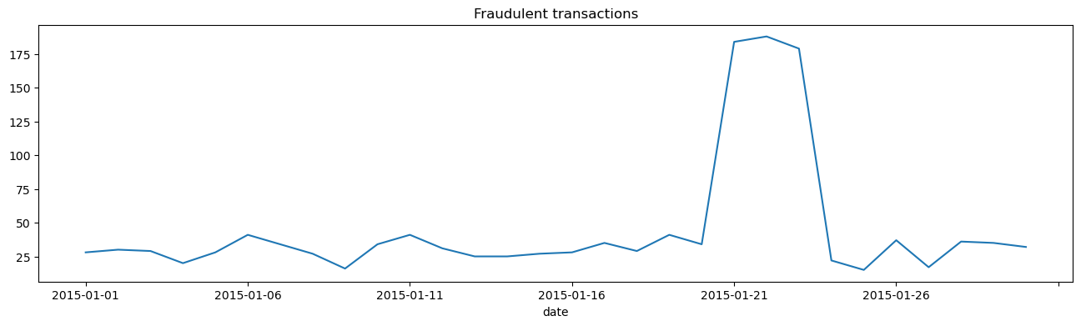
Fraudulent transactions
The fraudulent transactions peaked between 21/01 to 23/01

Slide 4
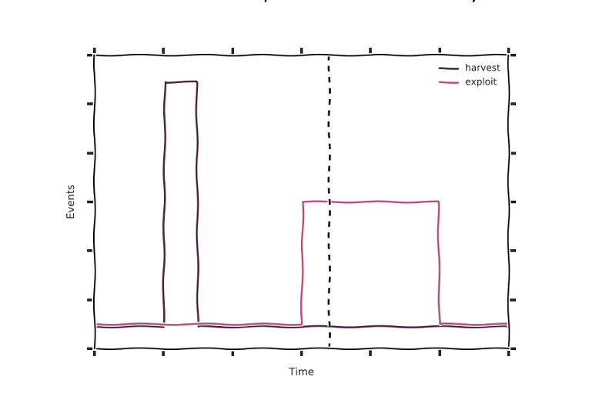
Compromise Point
“In a set of transactions, a common point of compromise can be identified when an unusually high number of defrauded accounts transacted with the same merchant some time before fraudulent transactions were seen for that account”

Slide 5
Data Perimeter
Break down January’s data into 3 periods:
1- 10 Jan. : Before account details harvesting
11 - 20 Jan. : Harvesting stage
21 - 31 Jan. Fraudulent transactions stage
Keep only the transactions of the defrauded accounts
Remove transactions that has happened from an account to a merchant more than once at the same day

Slide 6
Approach
For the data perimeter mentioned before estimate:
Difference between transactions happened the first 10 days compared to the following 10 days (“diff”)
The percentage change of this difference (“percentage_diff”)
The number of fraudulent accounts that interacted with each merchant before the fraudulent stage
The total number of accounts that interacted with each merchant before the fraudulent stage (“busy” merchant indication)

Slide 7
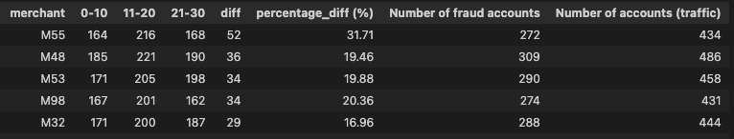
Results (sorted by difference)
M55 is the merchant with the highest increase in the number of defrauded accounts that transacted with it between the first and second ten-day period.
M48 ranks second. Even if it has interacted with more defrauded accounts this has probably happened because it is a busier merchant.

Slide 8
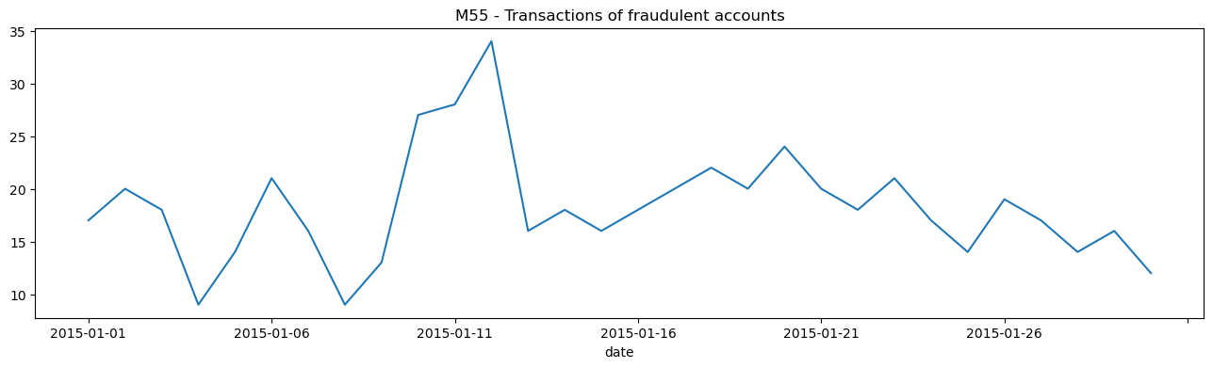
Harvesting Period
The harvesting period takes place between 10/01 to 12/01

Slide 9
Conclusion
The compromised merchant seems to be M55
The dates of compromise (harvesting period) is between 10/01 and 12/01
The dates of exploitation is between 21/01 to 23/01

